Slide 1

Devoir 3
Vérification et Validation en Modélisation Numérique
Validation
David Vidal
S. Paquette-Greenbaum, R. Zachariah, & K. A. N. Lippert
March 25th 2024
https://github.com/karolali22/MEC8211_PROJECT

Slide 2

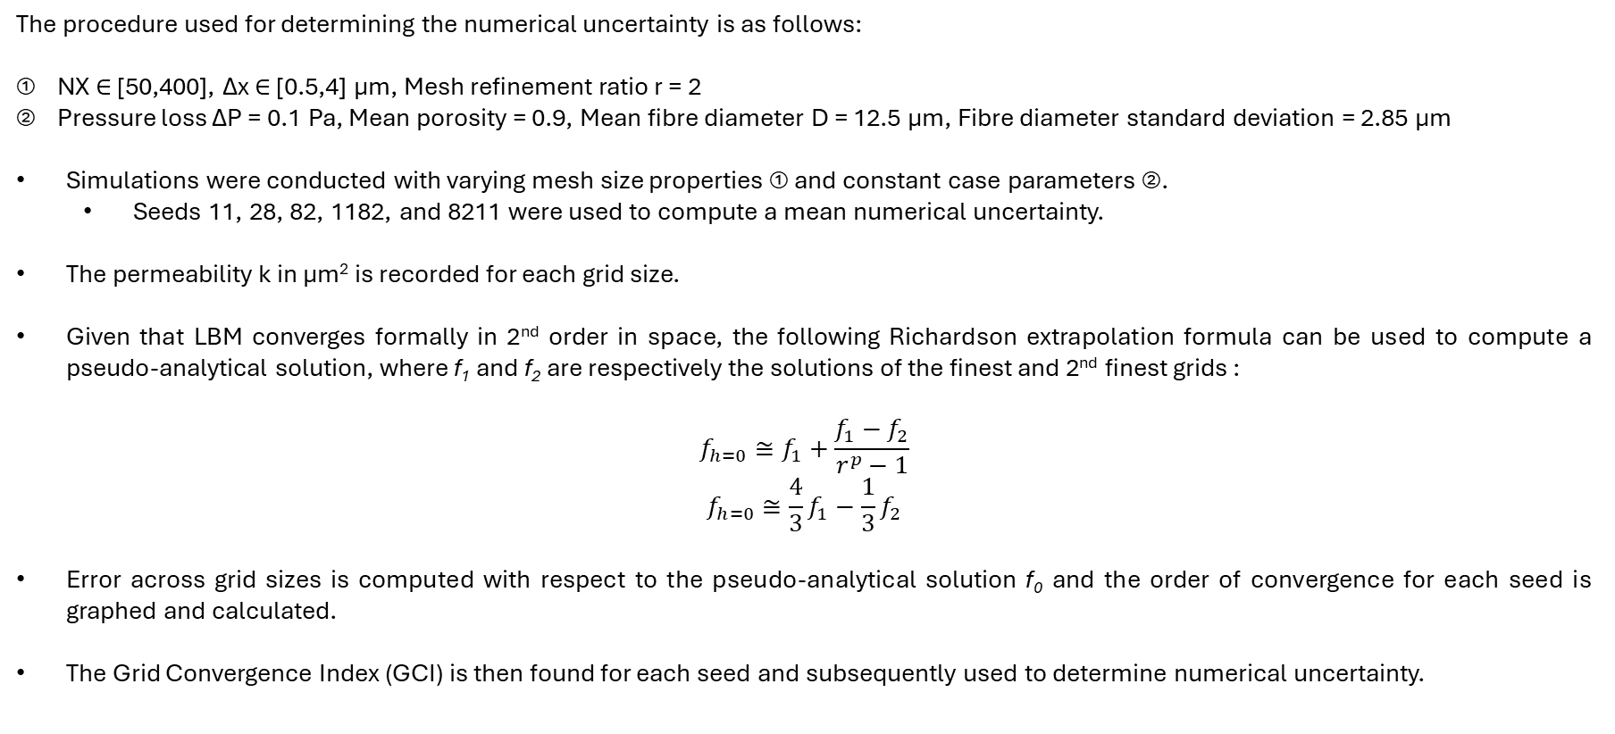
A. NUMERICAL UNCERTAINTY – u_{num}
The procedure used for determining the numerical uncertainty is as follows:
① NX ∈ [50,400], Δx ∈ [0.5,4] μm, Mesh refinement ratio r = 2
② Pressure loss ΔP = 0.1 Pa, Mean porosity = 0.9, Mean fibre diameter D = 12.5 μm, Fibre diameter standard deviation = 2.85 μm
Simulations were conducted with varying mesh size properties ① and constant case parameters ②.
Seeds 11, 28, 82, 1182, and 8211 were used to compute a mean numerical uncertainty.
The permeability k in μm² is recorded for each grid size.
Given that LBM converges formally in 2nd order in space, the following Richardson extrapolation formula can be used to compute a pseudo-analytical solution, where f₁ and f₂ are respectively the solutions of the finest and 2nd finest grids :
$$f_{h=0}≅f_{1}+\frac{f_{1}−f_{2}}{r^{p}−1}$$
$$f_{h=0}≅\frac{4}{3}f_{1}−\frac{1}{3}f_{2}$$
Error across grid sizes is computed with respect to the pseudo-analytical solution f₀ and the order of convergence for each seed is graphed and calculated.
The Grid Convergence Index (GCI) is then found for each seed and subsequently used to determine numerical uncertainty.

Slide 3
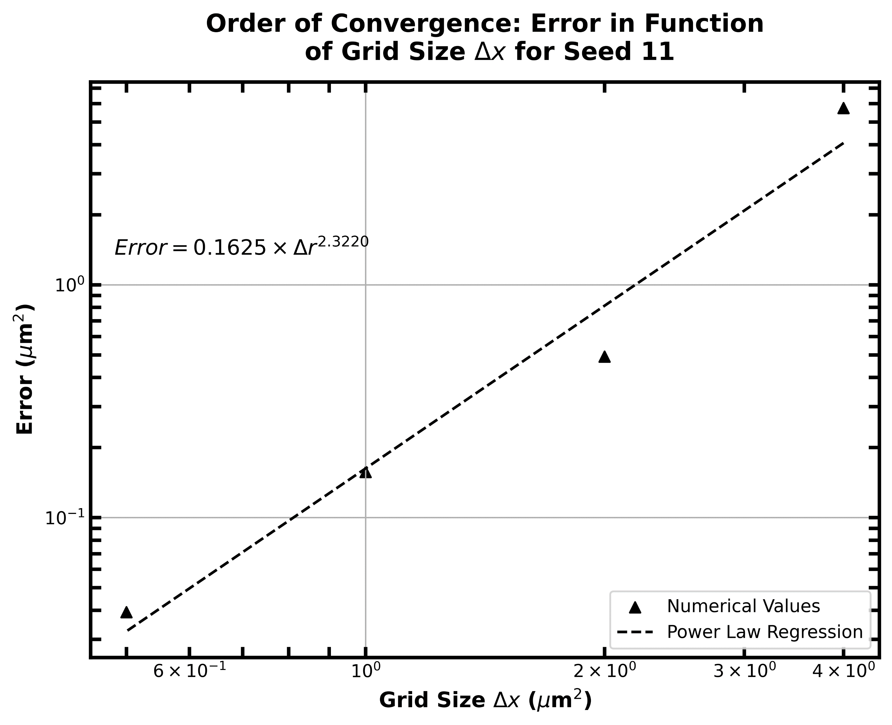
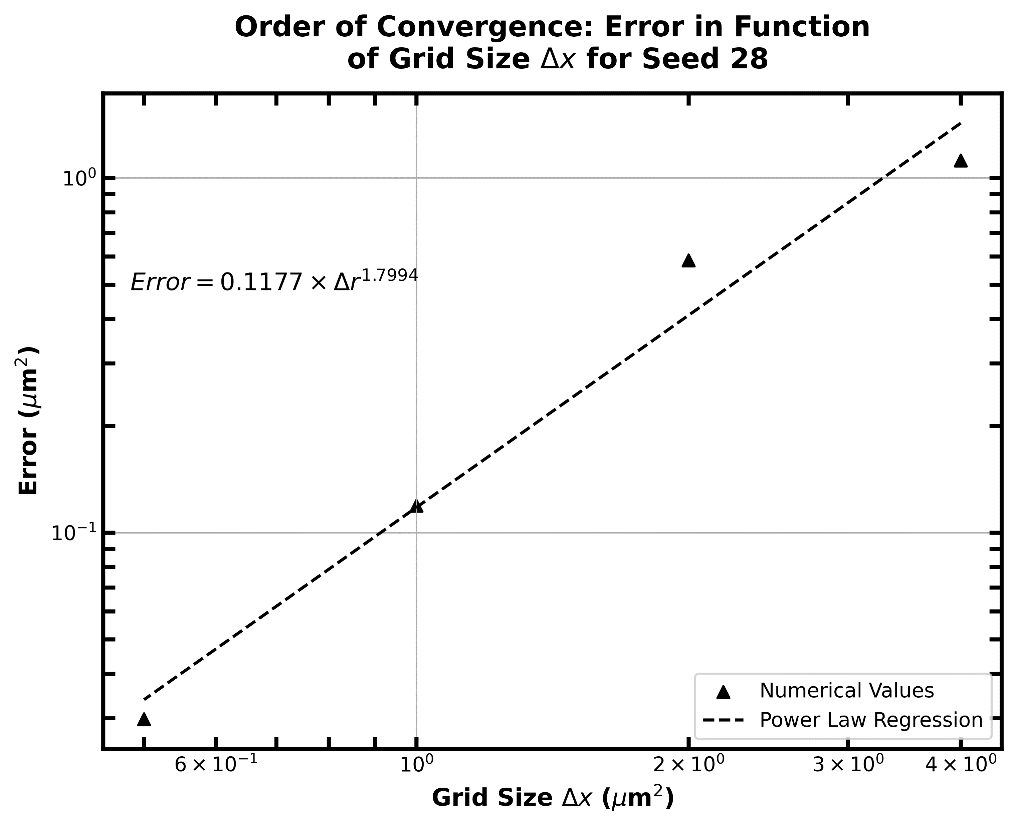
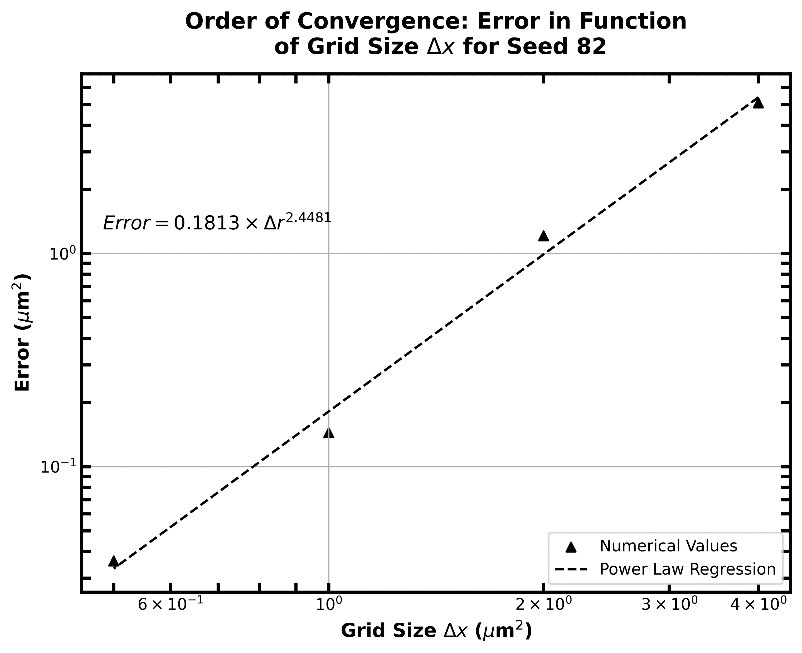
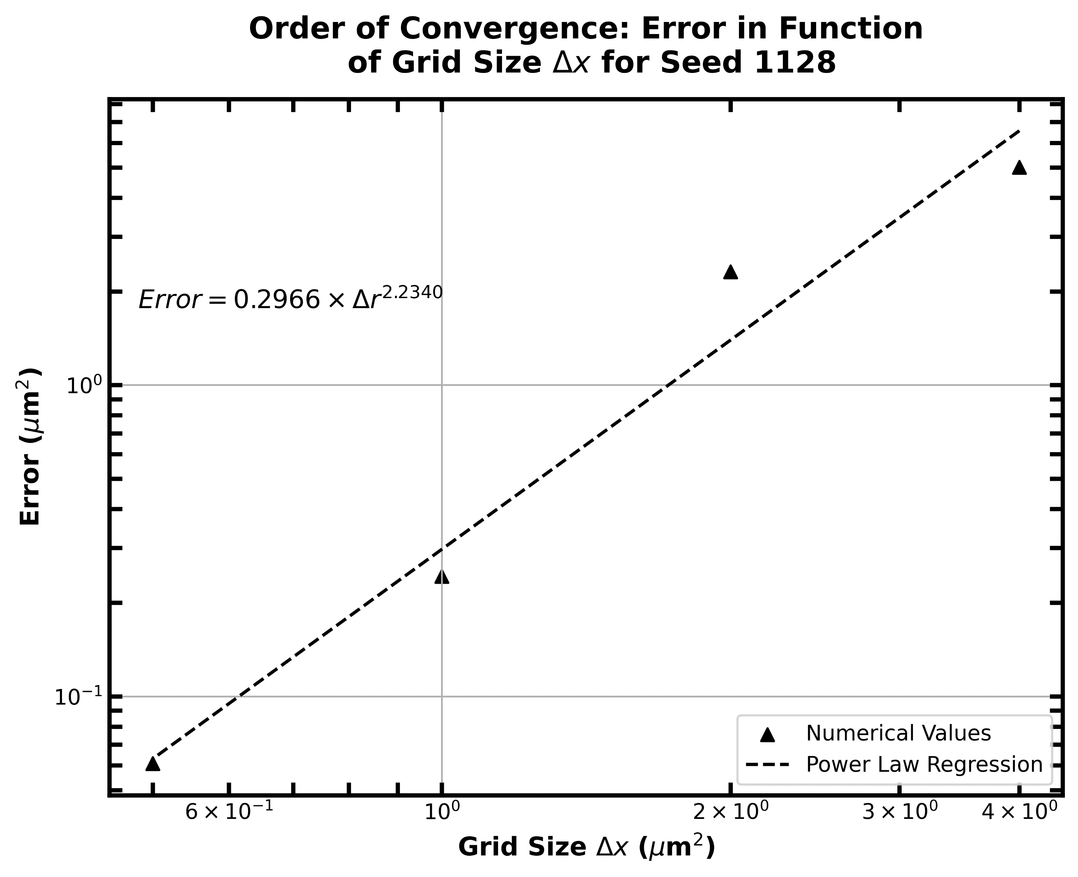
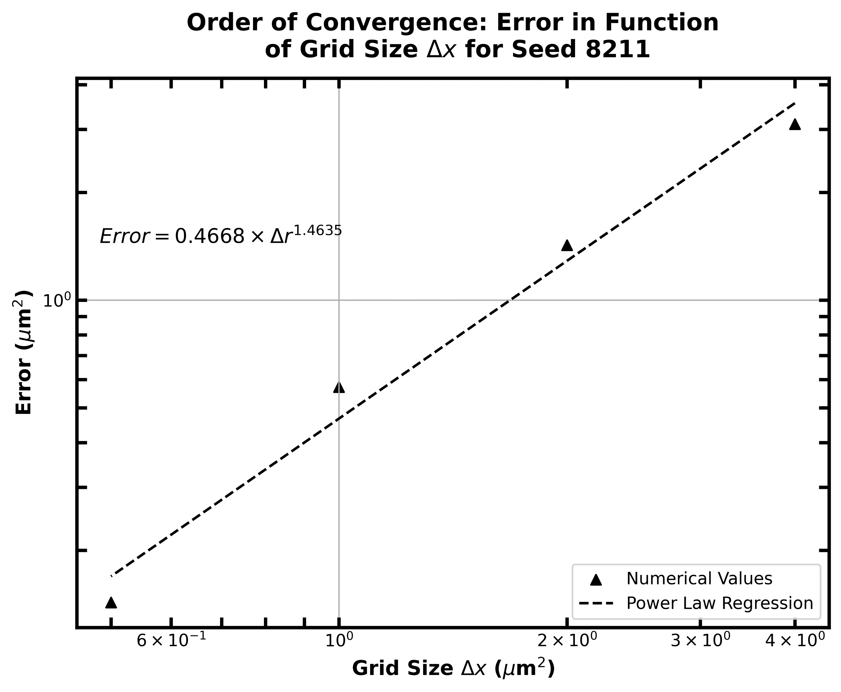
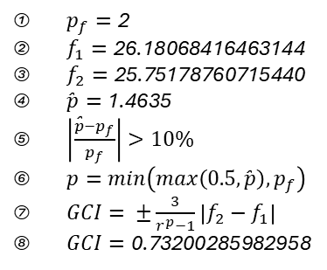
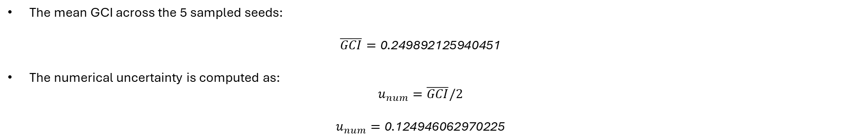
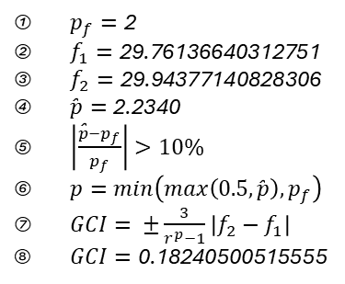
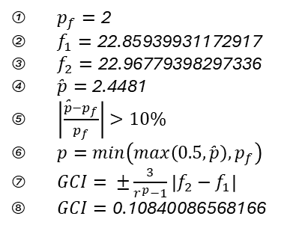
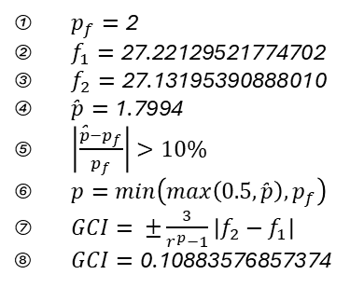
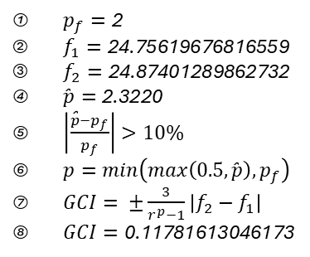
A. NUMERICAL UNCERTAINTY – u_{num} CONTINUED
$p_{f}=\text{2}$
$f_{1}=\text{24.75619676816559}$
$f_{2}=\text{24.87401289862732}$
$\text{̂}p=\text{2.3220}$
$\left|\frac{\text{̂}p−p_{f}}{p_{f}}\right|>10\%$
$p=min\left(max\left(0.5,\text{̂}p\right),p_{f}\right)$
$GCI= ±\frac{3}{r^{p}−1}\left|f_{2}−f_{1}\right|$
$GCI=\text{0.1178161304617}\text{3}$
$p_{f}=\text{2}$
$f_{1}=\text{27.22129521774702}$
$f_{2}=\text{27.131953908880}\text{1}$0
$\text{̂}p=\text{1.7994}$
$\left|\frac{\text{̂}p−p_{f}}{p_{f}}\right|>10\%$
$p=min\left(max\left(0.5,\text{̂}p\right),p_{f}\right)$
$GCI= ±\frac{3}{r^{p}−1}\left|f_{2}−f_{1}\right|$
$GCI=\text{0.1088357685737}\text{4}$
$p_{f}=\text{2}$
$f_{1}=\text{22.8593993117291}\text{7}$
$f_{2}=\text{22.9677939829733}\text{6}$
$\text{̂}p=\text{2.4481}$
$\left|\frac{\text{̂}p−p_{f}}{p_{f}}\right|>10\%$
$p=min\left(max\left(0.5,\text{̂}p\right),p_{f}\right)$
$GCI= ±\frac{3}{r^{p}−1}\left|f_{2}−f_{1}\right|$
$GCI=\text{0.10840086568166}$
$p_{f}=\text{2}$
$f_{1}=\text{29.7613664031275}\text{1}$
$f_{2}=\text{29.9437714082830}\text{6}$
$\text{̂}p=\text{2.}\text{234}\text{0}$
$\left|\frac{\text{̂}p−p_{f}}{p_{f}}\right|>10\%$
$p=min\left(max\left(0.5,\text{̂}p\right),p_{f}\right)$
$GCI= ±\frac{3}{r^{p}−1}\left|f_{2}−f_{1}\right|$
$GCI=\text{0.1824050051555}$5
$p_{f}=\text{2}$
$f_{1}=\text{26.18068416463144}$
$f_{2}=\text{25.751787607154}\text{40}$
$\text{̂}p=\text{1}\text{.4635}$
$\left|\frac{\text{̂}p−p_{f}}{p_{f}}\right|>10\%$
$p=min\left(max\left(0.5,\text{̂}p\right),p_{f}\right)$
$GCI= ±\frac{3}{r^{p}−1}\left|f_{2}−f_{1}\right|$
$GCI=\text{0.7320028598295}$8
The mean GCI across the 5 sampled seeds:
$$\overline{GCI}=\text{0}\text{.}\text{249892125940451}$$
The numerical uncertainty is computed as:
$$u_{num}=\overline{GCI}/2$$
$$u_{num}=\text{0}\text{.}\text{124946062970225}$$

Slide 4
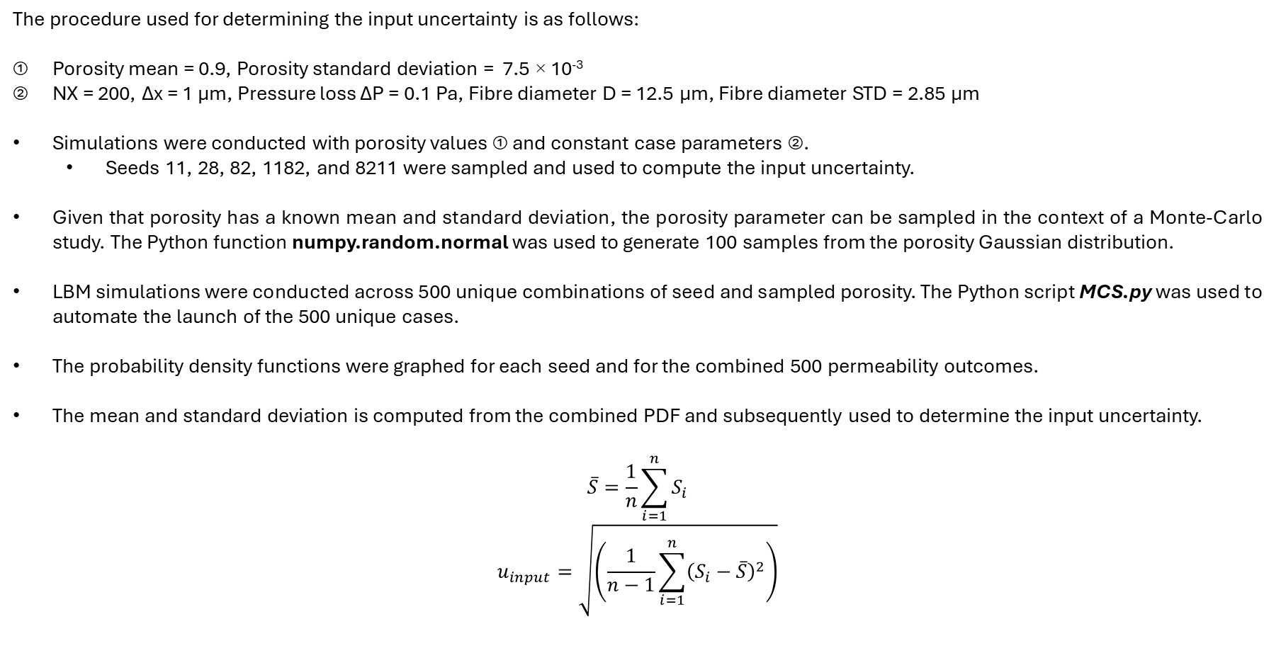
B. INPUT UNCERTAINTY – u_{input}
The procedure used for determining the input uncertainty is as follows:
Porosity mean = 0.9, Porosity standard deviation = 7.5 × 10⁻³
NX = 200, Δx = 1 μm, Pressure loss ΔP = 0.1 Pa, Fibre diameter D = 12.5 μm, Fibre diameter STD = 2.85 μm
Simulations were conducted with porosity values ① and constant case parameters ②.
Seeds 11, 28, 82, 1182, and 8211 were sampled and used to compute the input uncertainty.
Given that porosity has a known mean and standard deviation, the porosity parameter can be sampled in the context of a Monte-Carlo study. The Python function numpy.random.normal was used to generate 100 samples from the porosity Gaussian distribution.
LBM simulations were conducted across 500 unique combinations of seed and sampled porosity. The Python script MCS.py was used to automate the launch of the 500 unique cases.
The probability density functions were graphed for each seed and for the combined 500 permeability outcomes.
The mean and standard deviation is computed from the combined PDF and subsequently used to determine the input uncertainty.
$$\overline{S}=\frac{1}{n}\sum_{i=1}^{n}{S_{i}}$$
$$u_{input}=\sqrt{\left(\frac{1}{n−1}\sum_{i=1}^{n}{{\left(S_{i}−\overline{S}\right)}^{2}}\right)}$$

Slide 5
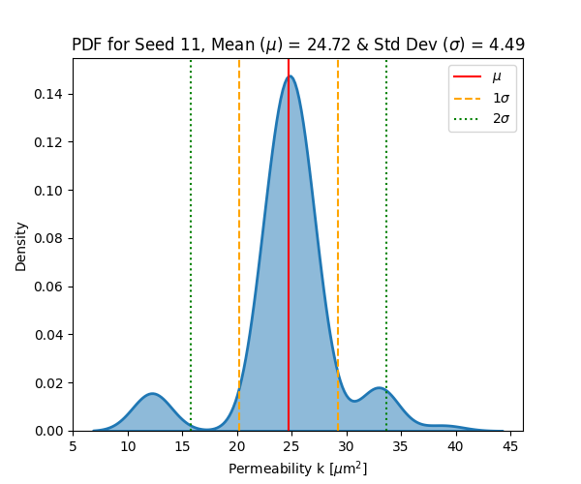
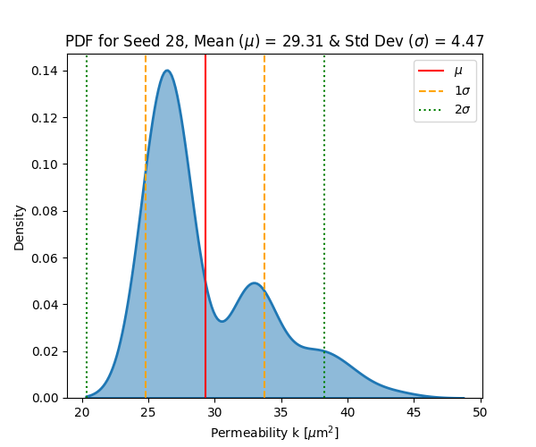
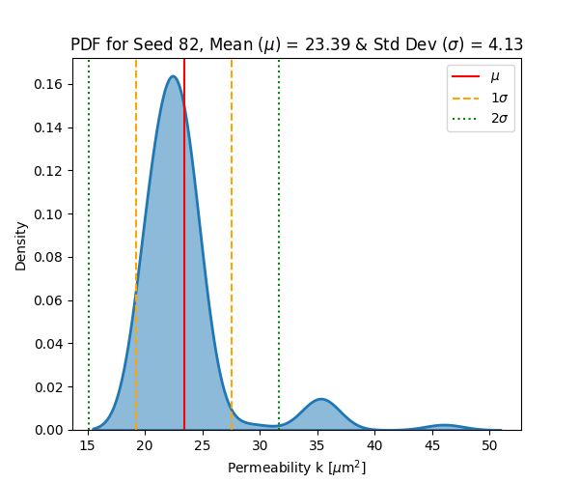
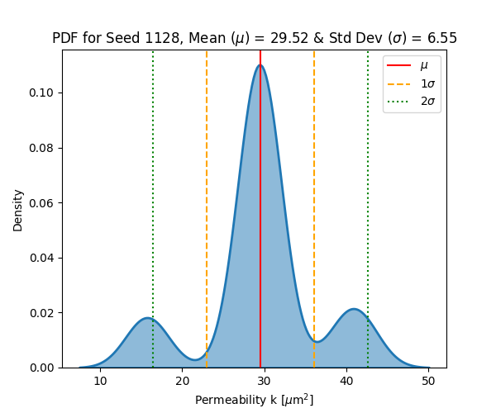
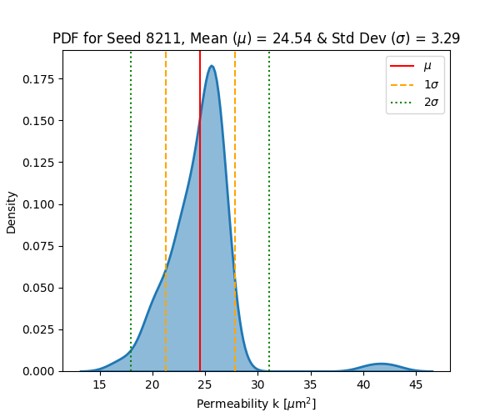
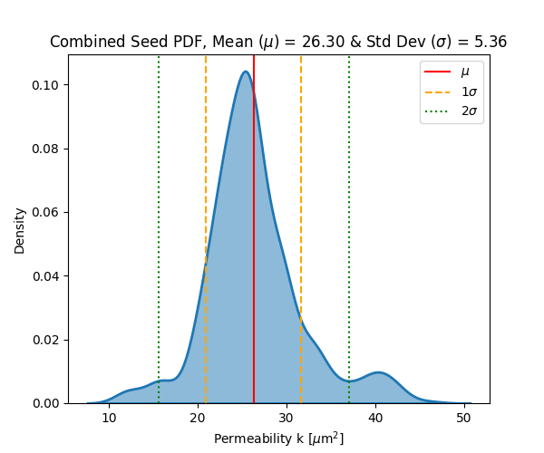
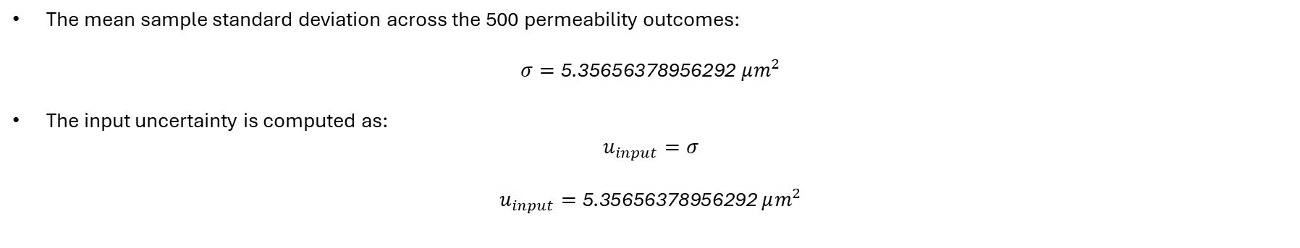
B. INPUT UNCERTAINTY – u_{input} CONTINUED
The mean sample standard deviation across the 500 permeability outcomes:
$$σ=\text{5}\text{.}\text{35656378956292} μm^{2}$$
The input uncertainty is computed as:
$$u_{input}=σ$$
$$u_{input}=\text{5}\text{.}\text{35656378956292 }μm^{2}$$

Slide 6
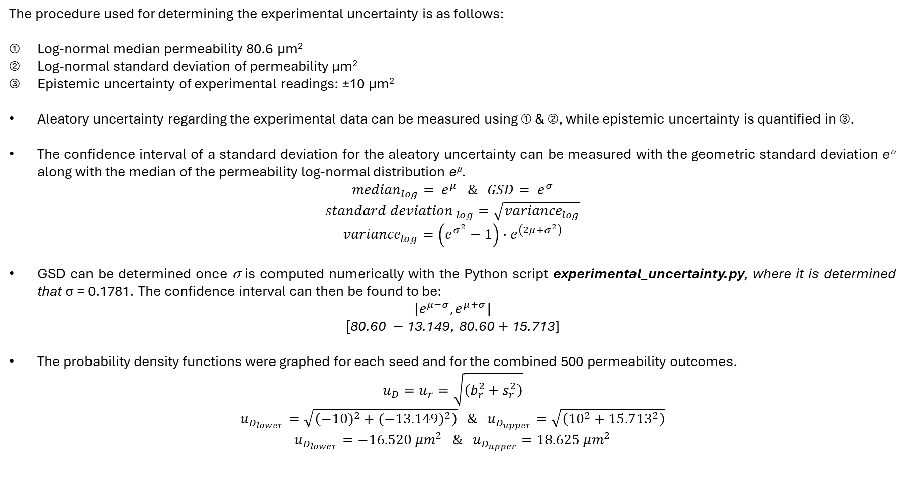
C. EXPERIMENTAL UNCERTAINTY – u_{D}
The procedure used for determining the experimental uncertainty is as follows:
Log-normal median permeability 80.6 μm²
Log-normal standard deviation of permeability μm²
Epistemic uncertainty of experimental readings: ±10 μm²
Aleatory uncertainty regarding the experimental data can be measured using ① & ②, while epistemic uncertainty is quantified in ③.
The confidence interval of a standard deviation for the aleatory uncertainty can be measured with the geometric standard deviation e^{σ} along with the median of the permeability log-normal distribution e^{μ}.
$${median}_{log}= e^{μ} \& GSD= e^{σ}$$
$${standard deviation }_{log}=\sqrt{{variance}_{log}}$$
$${variance}_{log}=\left(e^{σ^{2}}−1\right)∙e^{\left(2μ+σ^{2}\right)}$$
GSD can be determined once σ is computed numerically with the Python script experimental_uncertainty.py, where it is determined that σ = 0.1781. The confidence interval can then be found to be:
$${[e}^{μ−σ},e^{μ+σ}]$$
$$[\text{80}\text{.}\text{60} −\text{13}\text{.}\text{149}, \text{80}\text{.}\text{60 }\text{+} \text{15}\text{.}\text{713}\text{]}$$
The probability density functions were graphed for each seed and for the combined 500 permeability outcomes.
$$u_{D}=u_{r}=\sqrt{\left(b_{r}^{2}+s_{r}^{2}\right)}$$
$$u_{D_{lower}}=\sqrt{\left({−10)}^{2}+{(−13.149)}^{2}\right)} \& u_{D_{upper}}=\sqrt{\left({10}^{2}+{15.713}^{2}\right)}$$
$$u_{D_{lower}}=−16.520 μm^{2} \& u_{D_{upper}}=18.625 μm^{2}$$

Slide 7
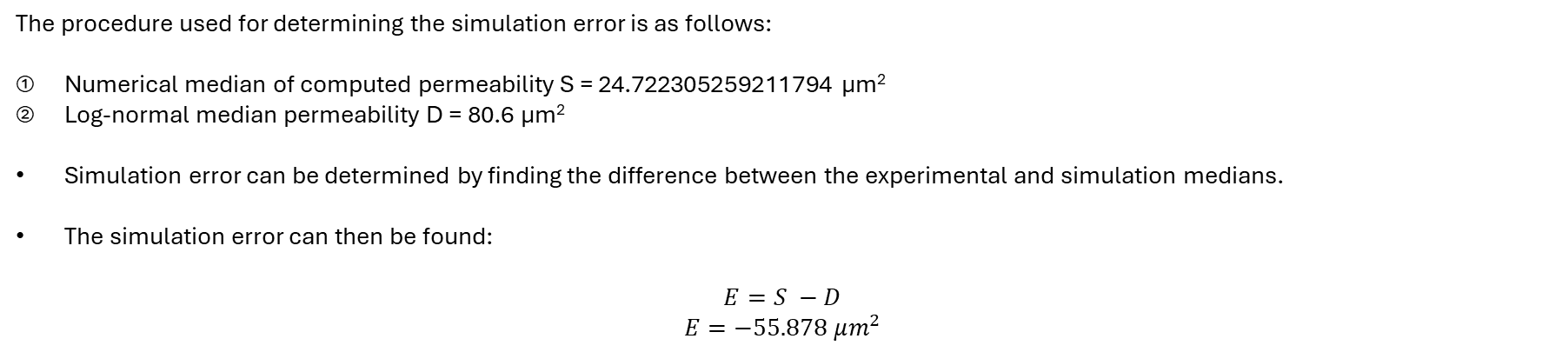
D. SIMULATION ERROR – E
The procedure used for determining the simulation error is as follows:
Numerical median of computed permeability S = 24.722305259211794 μm²
Log-normal median permeability D = 80.6 μm²
Simulation error can be determined by finding the difference between the experimental and simulation medians.
The simulation error can then be found:
$$E=S −D$$
$$E=−55.878 μm^{2}$$

Slide 8
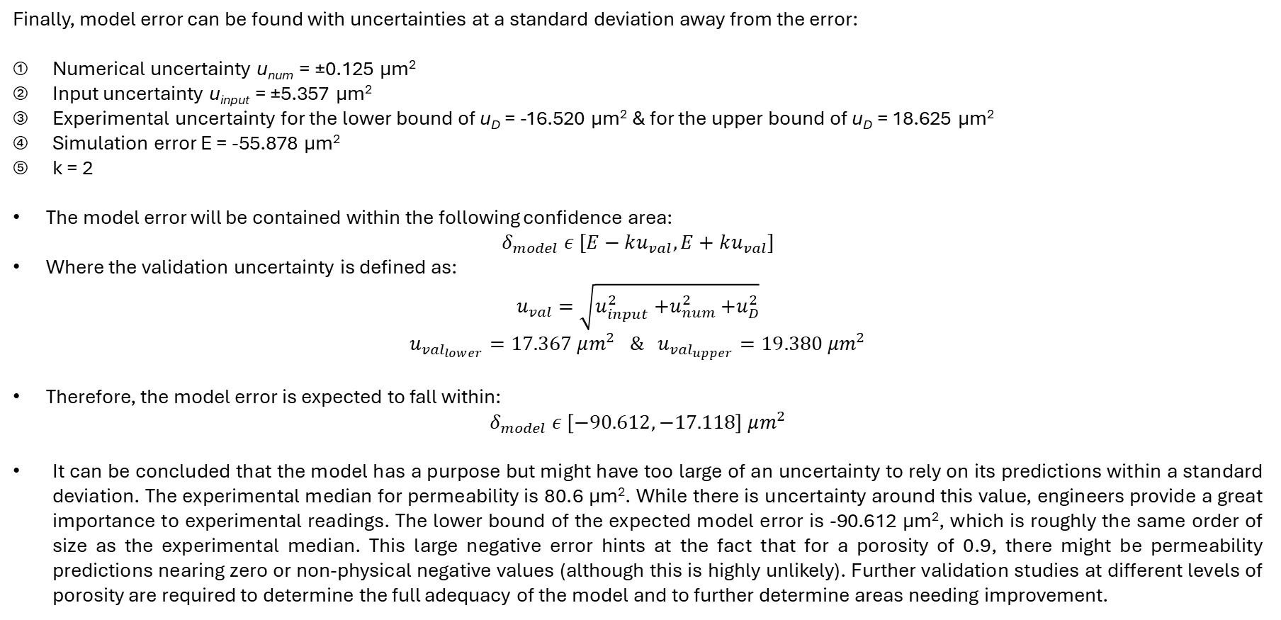
E. MODEL ERROR – δ_{model}
Finally, model error can be found with uncertainties at a standard deviation away from the error:
Numerical uncertainty u_{num} = ±0.125 μm²
Input uncertainty u_{input} = ±5.357 μm²
Experimental uncertainty for the lower bound of u_{D} = -16.520 μm² & for the upper bound of u_{D} = 18.625 μm²
Simulation error E = -55.878 μm²
k = 2
The model error will be contained within the following confidence area:
$$δ_{model} ε [E−ku_{val}, E+ku_{val}]$$
Where the validation uncertainty is defined as:
$$u_{val}=\sqrt{u_{input}^{2}{+u}_{num}^{2}+u_{D}^{2}}$$
$$u_{{val}_{lower}}=17.367 μm^{2} \& u_{{val}_{upper}}=19.380 μm^{2}$$
Therefore, the model error is expected to fall within:
$$δ_{model} ε \left[−90.612, −17.118\right] μm^{2}$$
It can be concluded that the model has a purpose but might have too large of an uncertainty to rely on its predictions within a standard deviation. The experimental median for permeability is 80.6 μm². While there is uncertainty around this value, engineers provide a great importance to experimental readings. The lower bound of the expected model error is -90.612 μm², which is roughly the same order of size as the experimental median. This large negative error hints at the fact that for a porosity of 0.9, there might be permeability predictions nearing zero or non-physical negative values (although this is highly unlikely). Further validation studies at different levels of porosity are required to determine the full adequacy of the model and to further determine areas needing improvement.

Slide 9

THANK YOU!

